Slide 1
Simple Shooter Game:
using Processing
By: Javier Ramirez

Slide 2
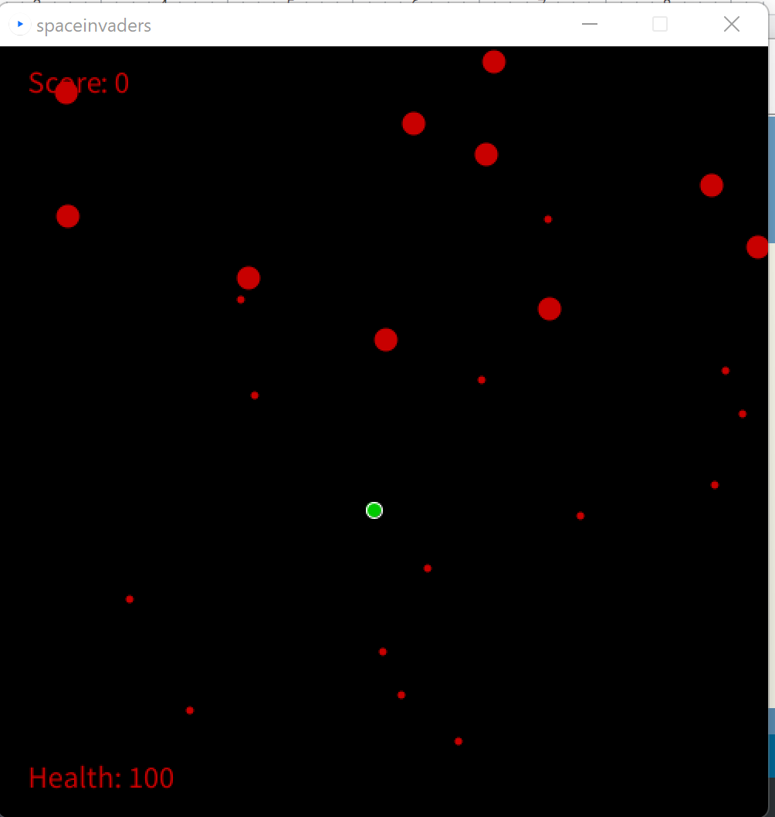
Idea behind the game
The purpose behind this game was to attempt and replicate the game space invaders but decided to use some of the game mechanics as my inspiration, while adding score, a health bar , and the ability to move around with the UP, DOWN, LEFT, RIGHT arrow keys. However, the shooting mechanics are limited to an upward direction from the “Ship” the user controls when pressing spacebar. Next we will look at the Important functions used.

Slide 3
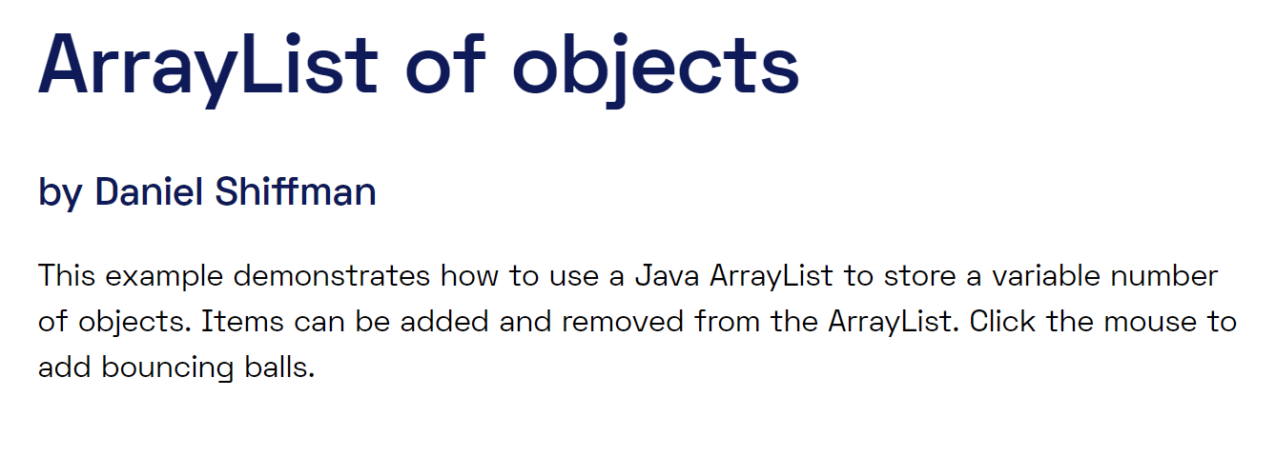
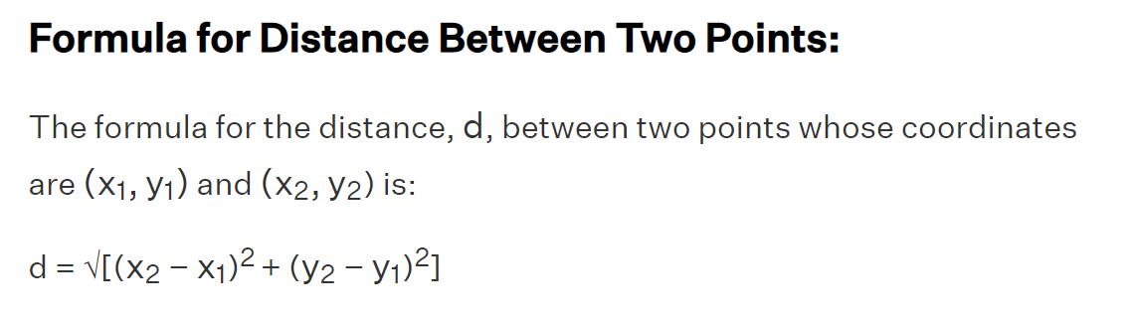
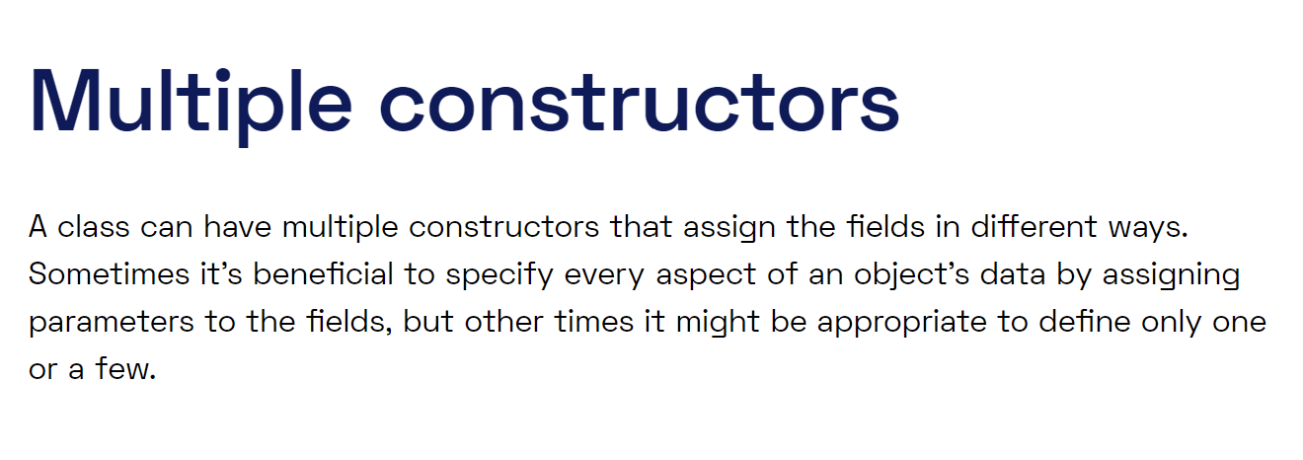
Important Functions
-ArrayList of object bullets, enemies, bombs
-ArrayList, Array
-Objects
-Ellipse
-Multiple constructors
-KeyPressed
-KeyHold
-POW()
processing.org/examples

Slide 4
Final implementations
Create multiple levels, or waves Ex: have the user continue to new level or level select with harder difficulty/enemy ships that attack you directly, or have more mobs spawn in once score reaches 10 that shoot at a faster rate than before.
Replace the ellipse instead with .png images of a ship similarly seen concept from asteroid Game example.
Create start up screen, tutorial , pause, and credit screen once you win,lose,or pause the game

Slide 5
Reference used to find distance of 2 points.
https://stackoverflow.com/questions/6510837/distance-between-two-points-in-processing-app
https://processing.org/examples/multipleconstructors.html
https://processing.org/reference/pow_.html
https://processing.org/reference/ArrayList.html
https://processing.org/reference/Array.html

